Slide 1
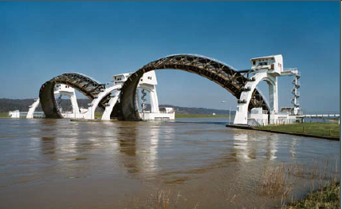
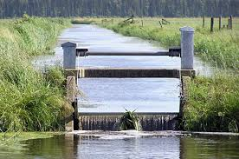
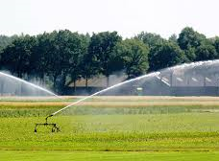
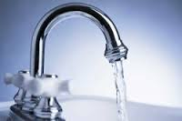
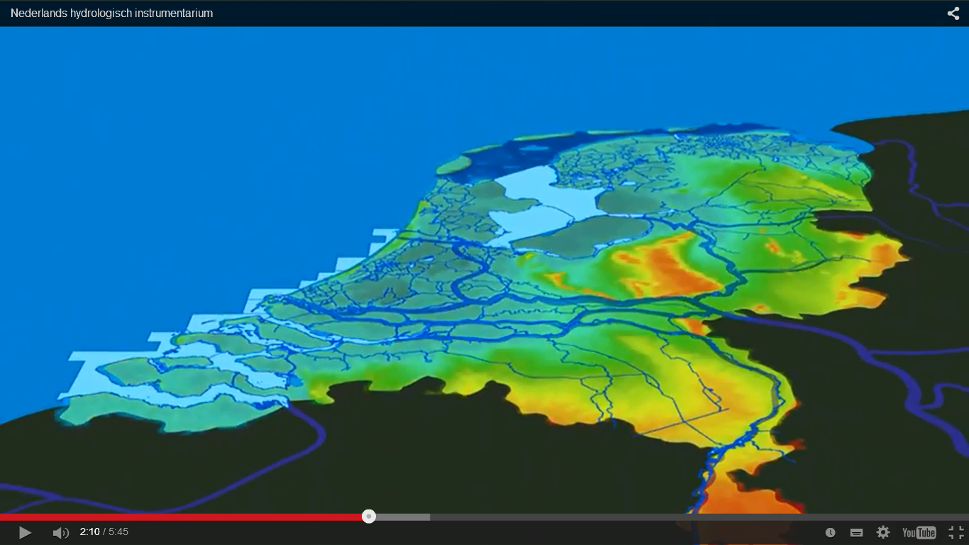
NHI: the Netherlands Hydrological Instrument
Kees Bons
Deltares

Slide 2
Original context NHI: national policy analysis

Slide 3
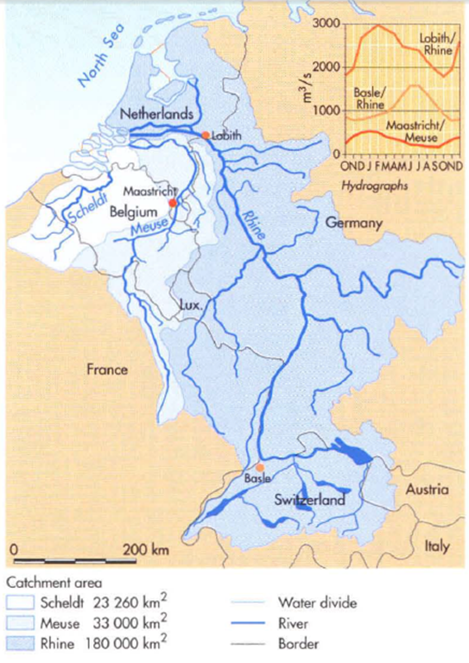
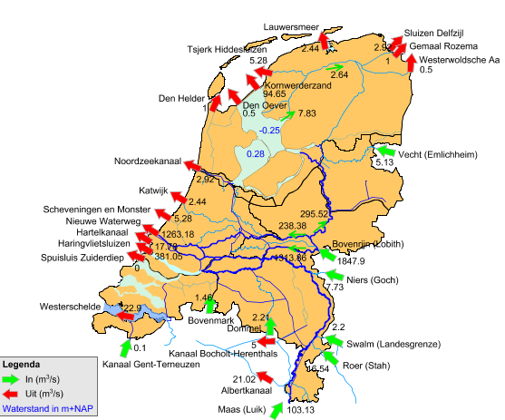
National Water Management: waterbalances …
Catchments river Rhine, Meuse
What happens within the Netherlands ?

Slide 4
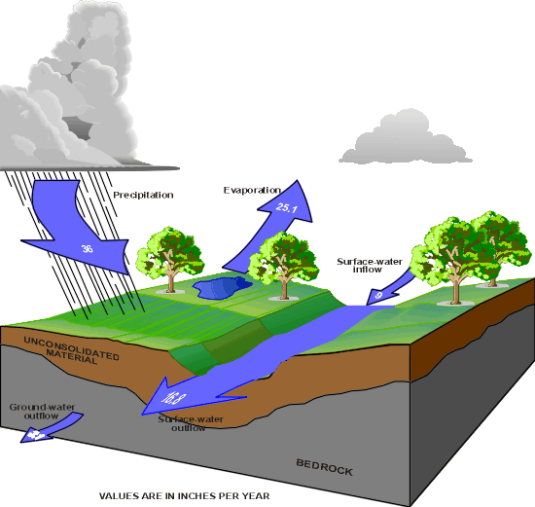
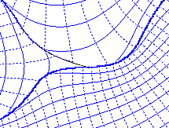
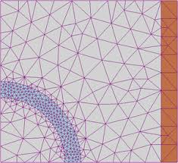
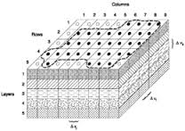
Start of NHI, 10 years ago:
different approaches, different models
Ministry 1
Ministry 2
Regional authorities
(AEM)
---------
MOZART
---------
(FEM)
---------
(FDM)

Slide 5
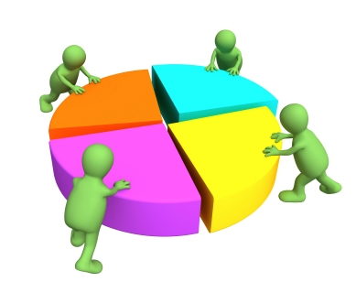
Plans in 2005: joint effort ministries + institutes one national hydrological instrument NL
Efficiency (€)
Quality improvement, better than old national models
International state of the art instrument
Preferably open data and sources

Slide 6
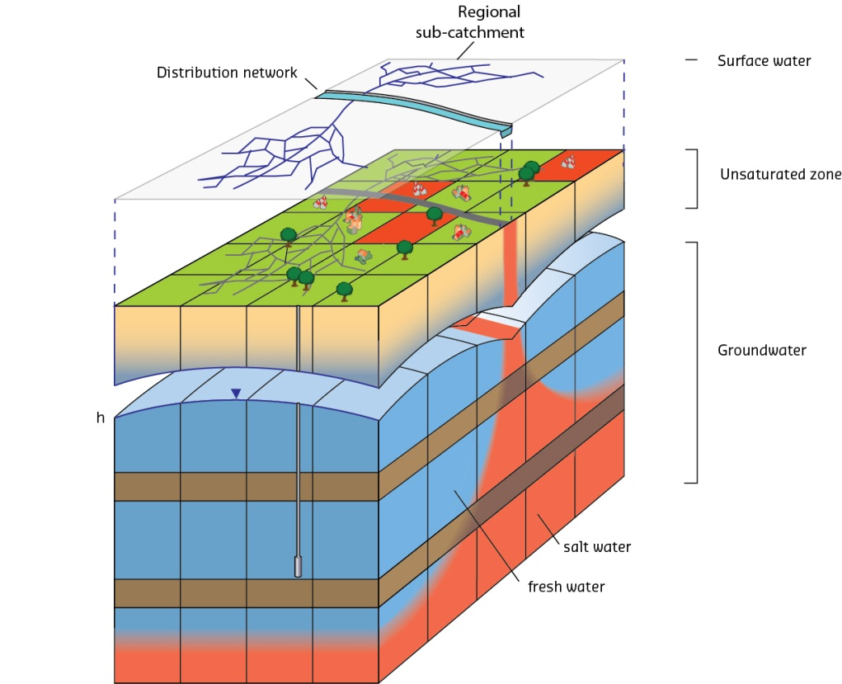
Advice for the new hydrological model (2006)
coupled models surface water - saturated – vadose zone
cellsize 250 m
transient (1 – 10 days)
conceptual (lumped) approach for drainage
salt intrusion included
preferably consistent with regional models

Slide 7
So we made NHI (2006-2010): overview of models
vadose zone
Metaswap
(250 m, 1-10 days, 1D)
regional surface water
Mozart
(1- 10 days)
(0,5 – 5 km2)
national surface
water
Distribution Model
nodes+lines
(10 days)
groundwater
Modflow
(250 m, 1-10 day, 3D)

Slide 8
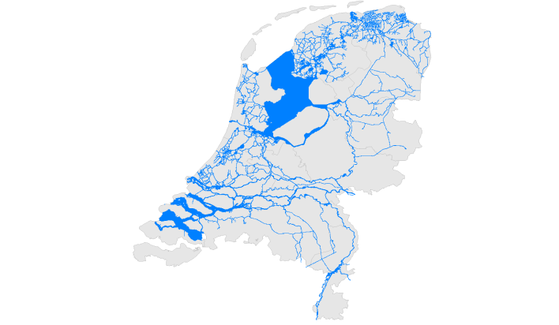
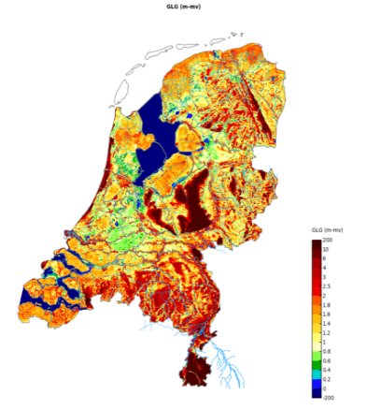
Examples NHI
moisture content
Water demand
(e.g. level control, irrigation, flushing)
National water distribution
lowest (mean) groundwater level

Slide 9
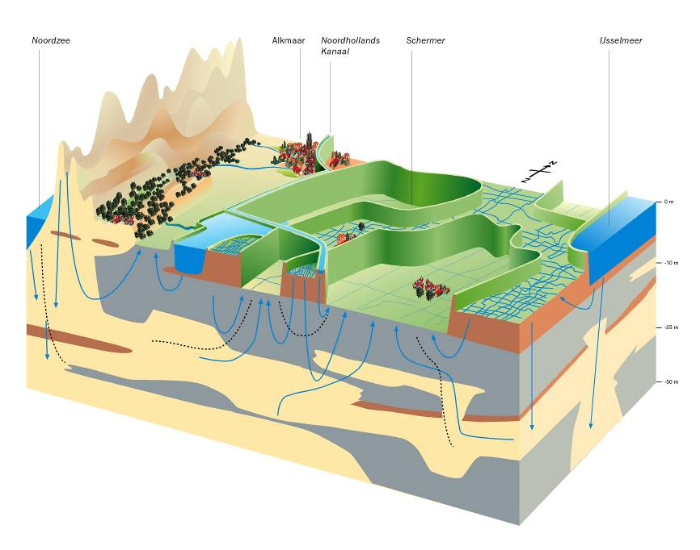
Model component 1. IMOD-MODFLOW (saturated)
Saturated zone:
625.000 cells, 250 m (~ 440 km2 )
7 layers (WQ up to 24 layers)
use of special version of MODFLOW:
(iMOD) to handle large datasets
Notes:
In the Netherlands high data availability. A blessing, but also a burden on modeling projects!

Slide 10
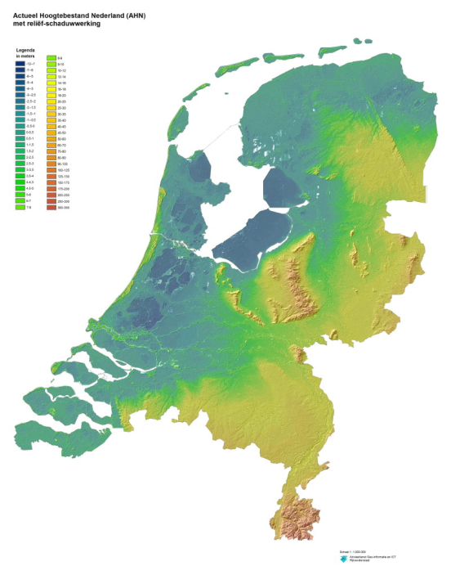
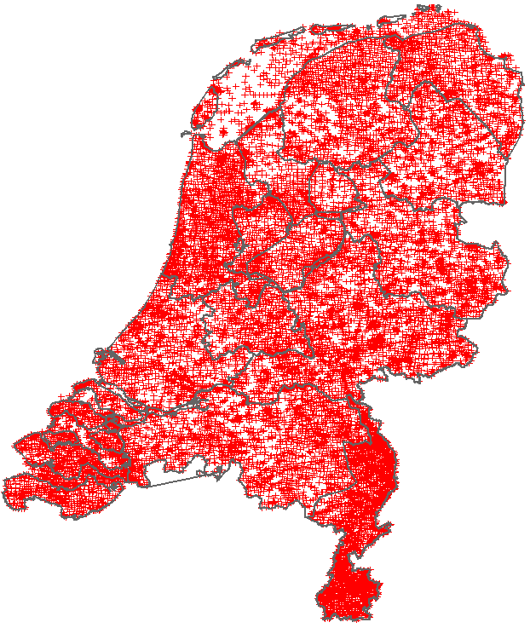
In Netherlands large detailed datasets are available
DEM 0.5m x 0.5m
~16,000 boreholes

Slide 11
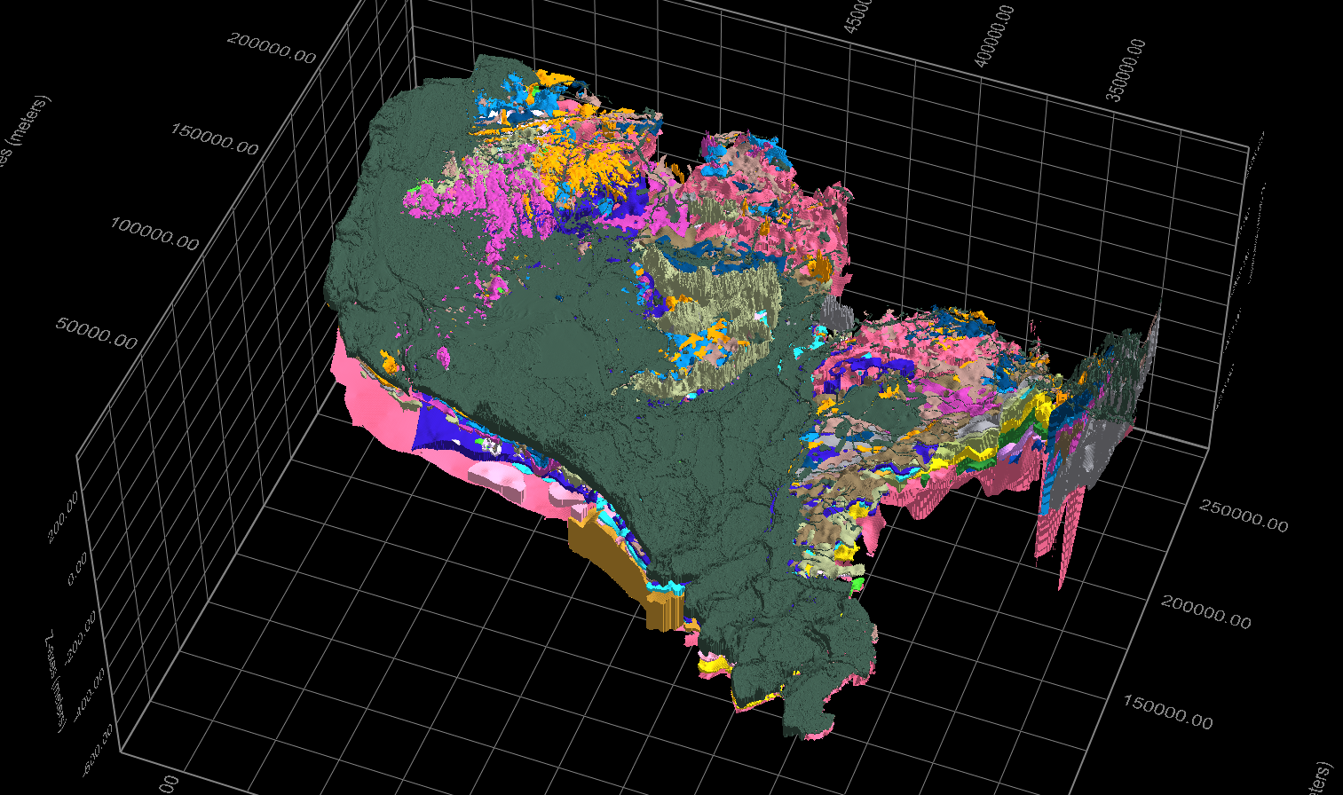
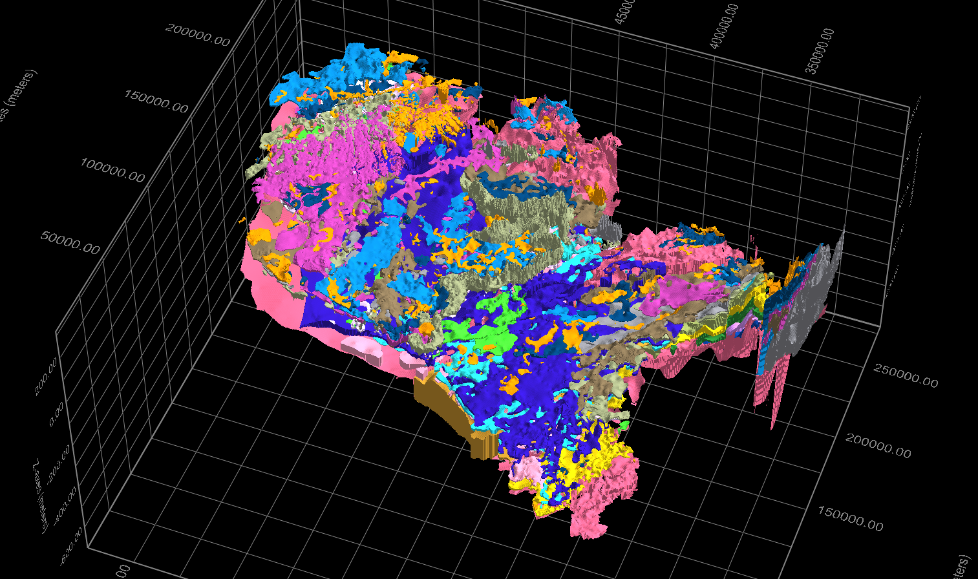
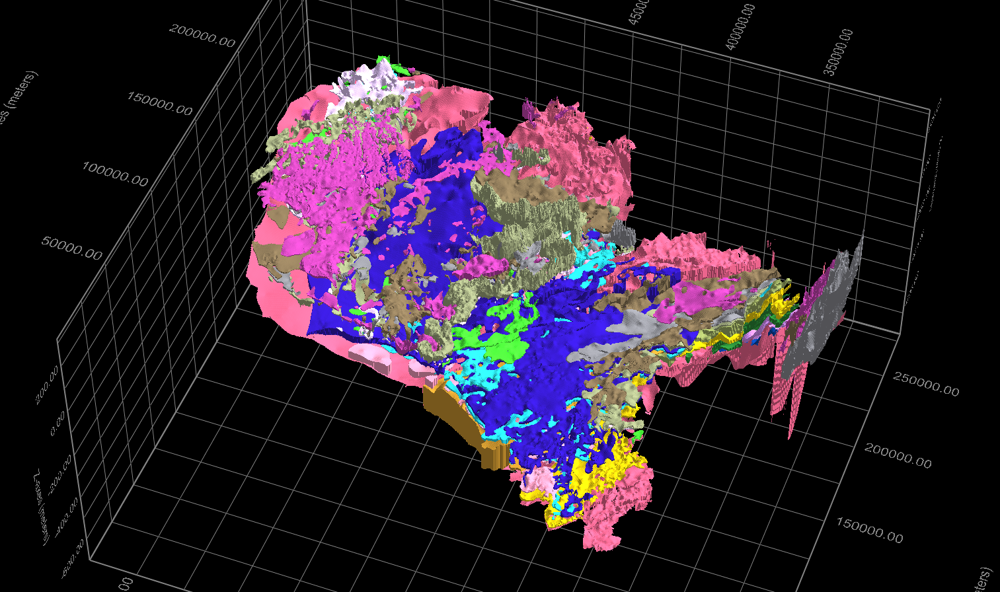
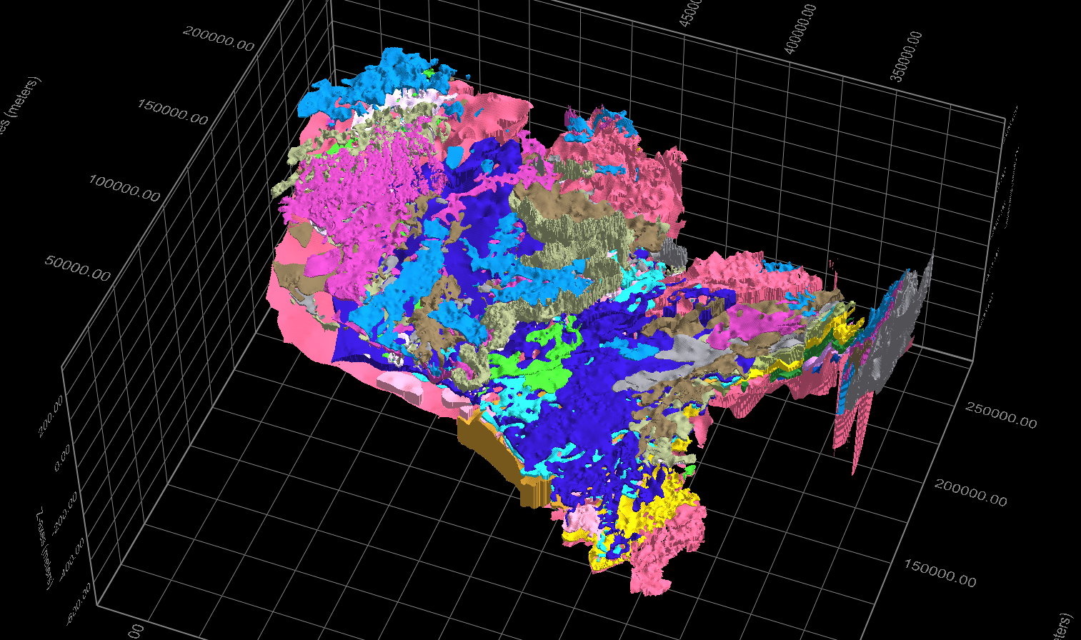
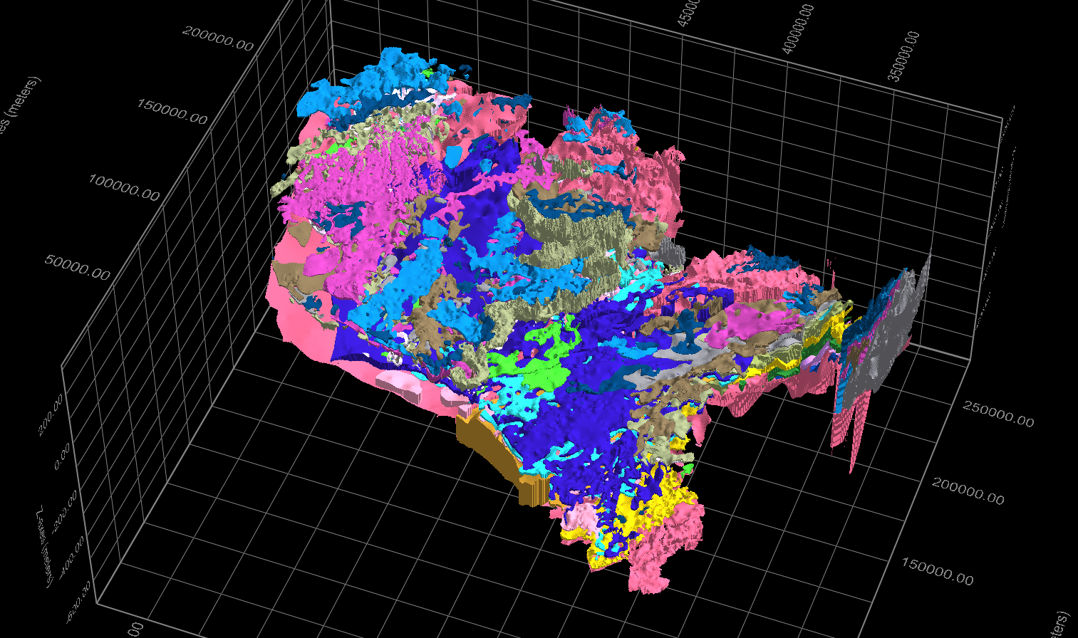
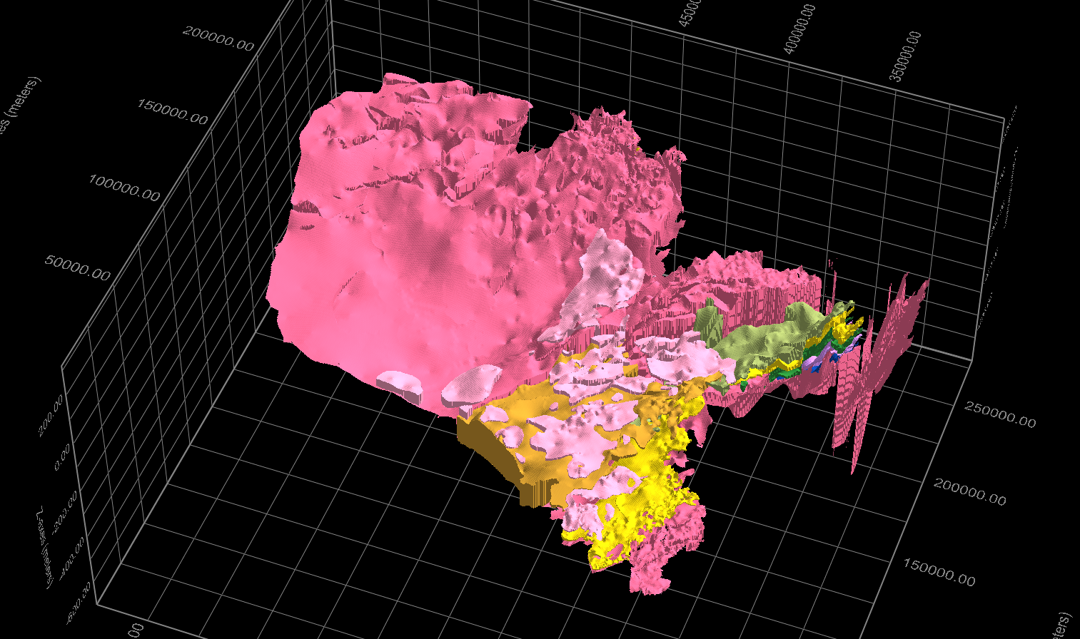
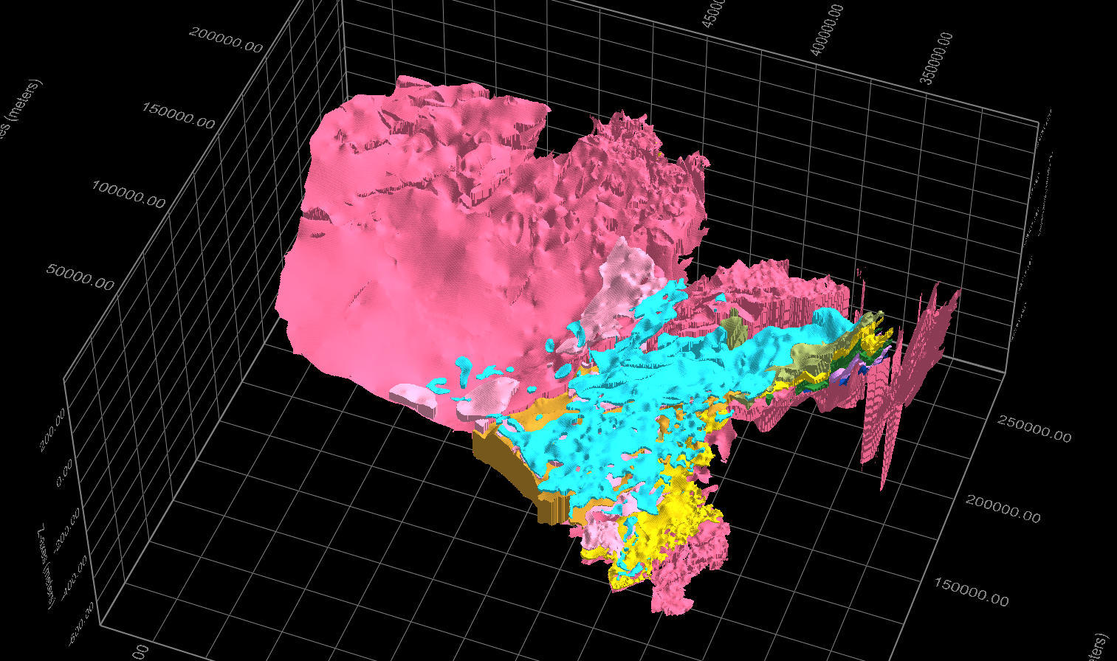
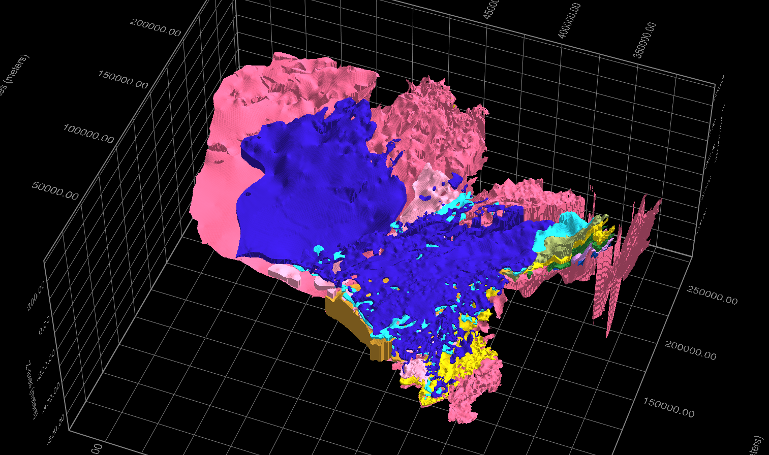
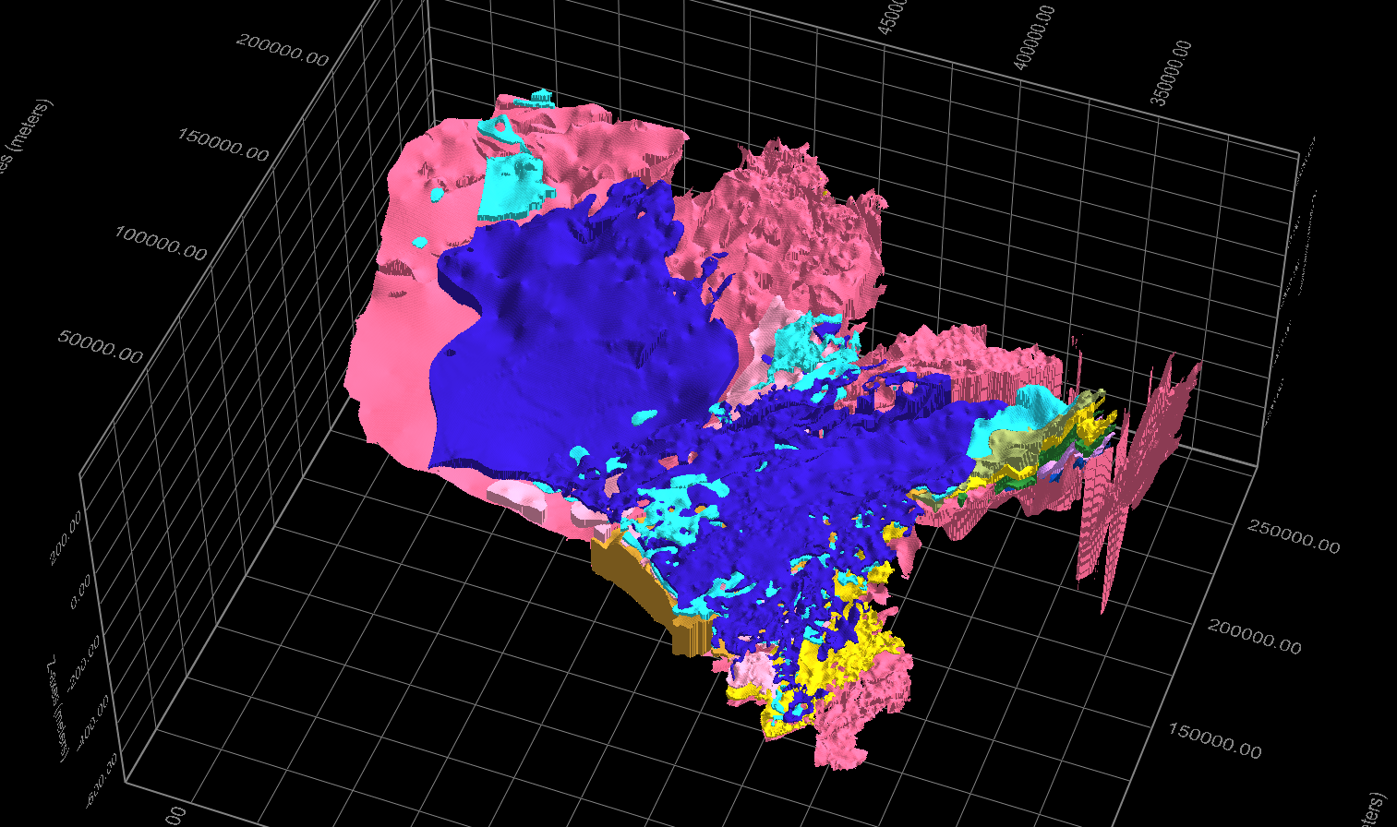
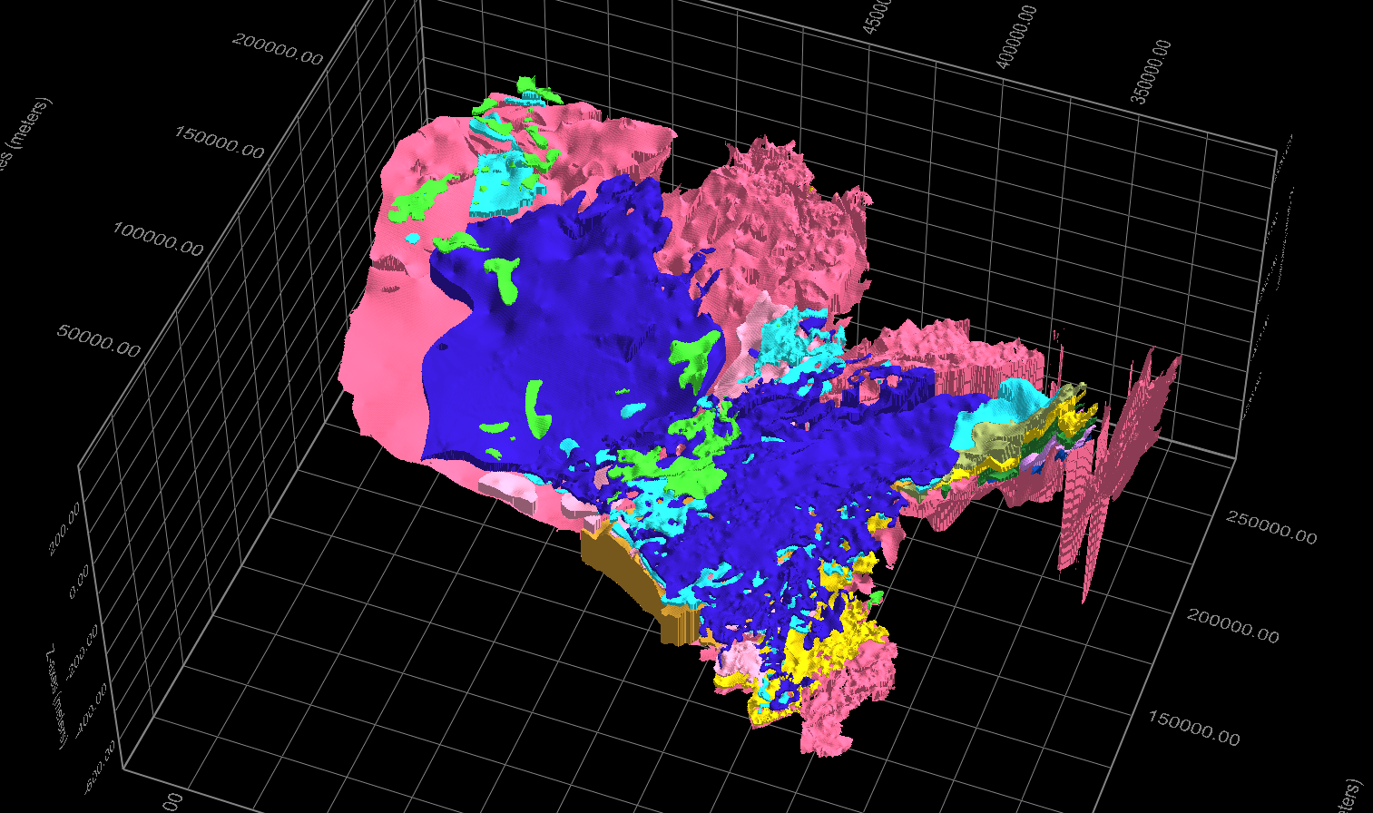
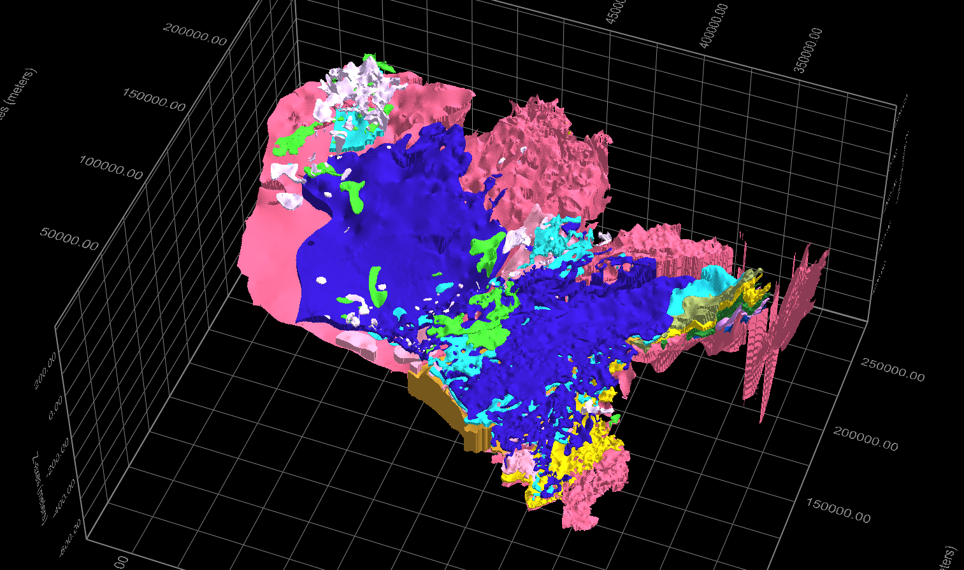
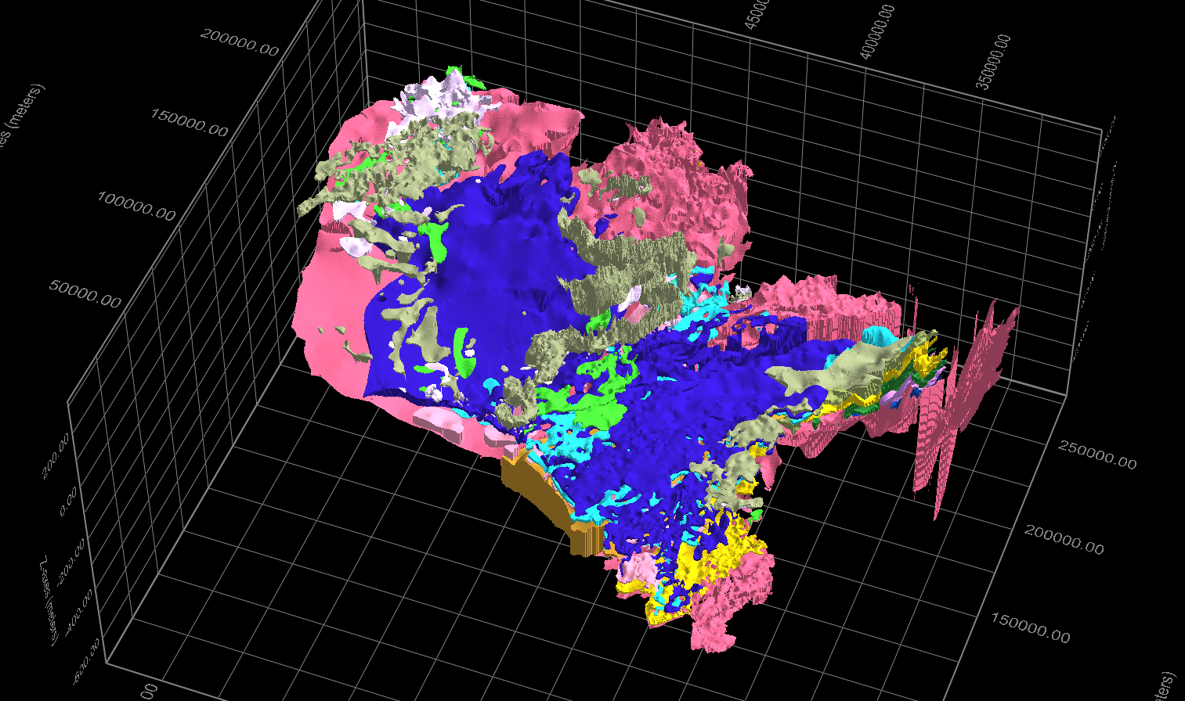
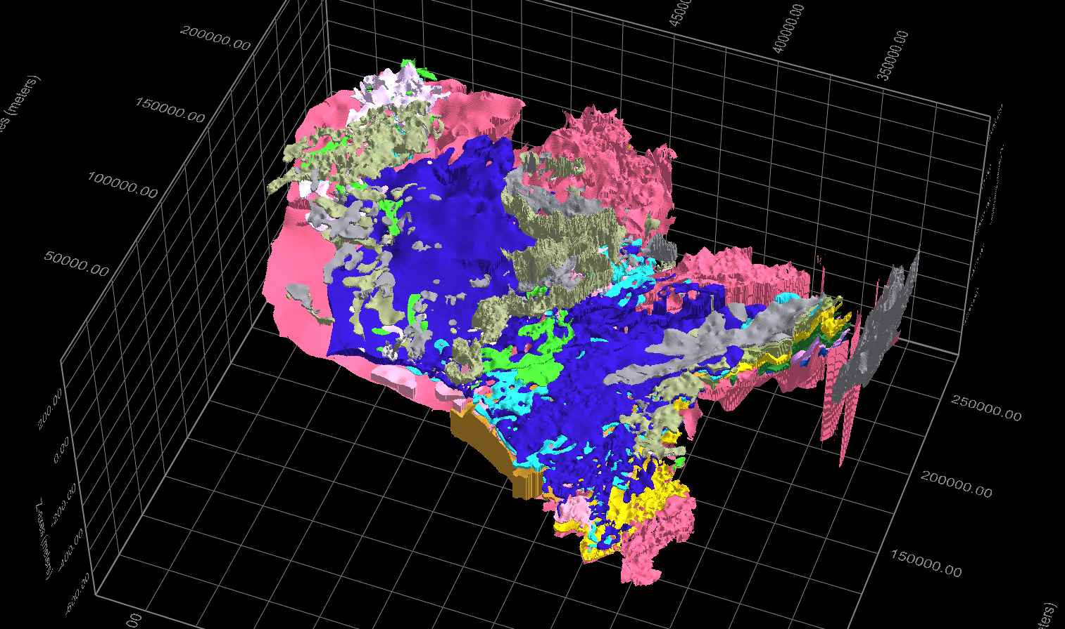
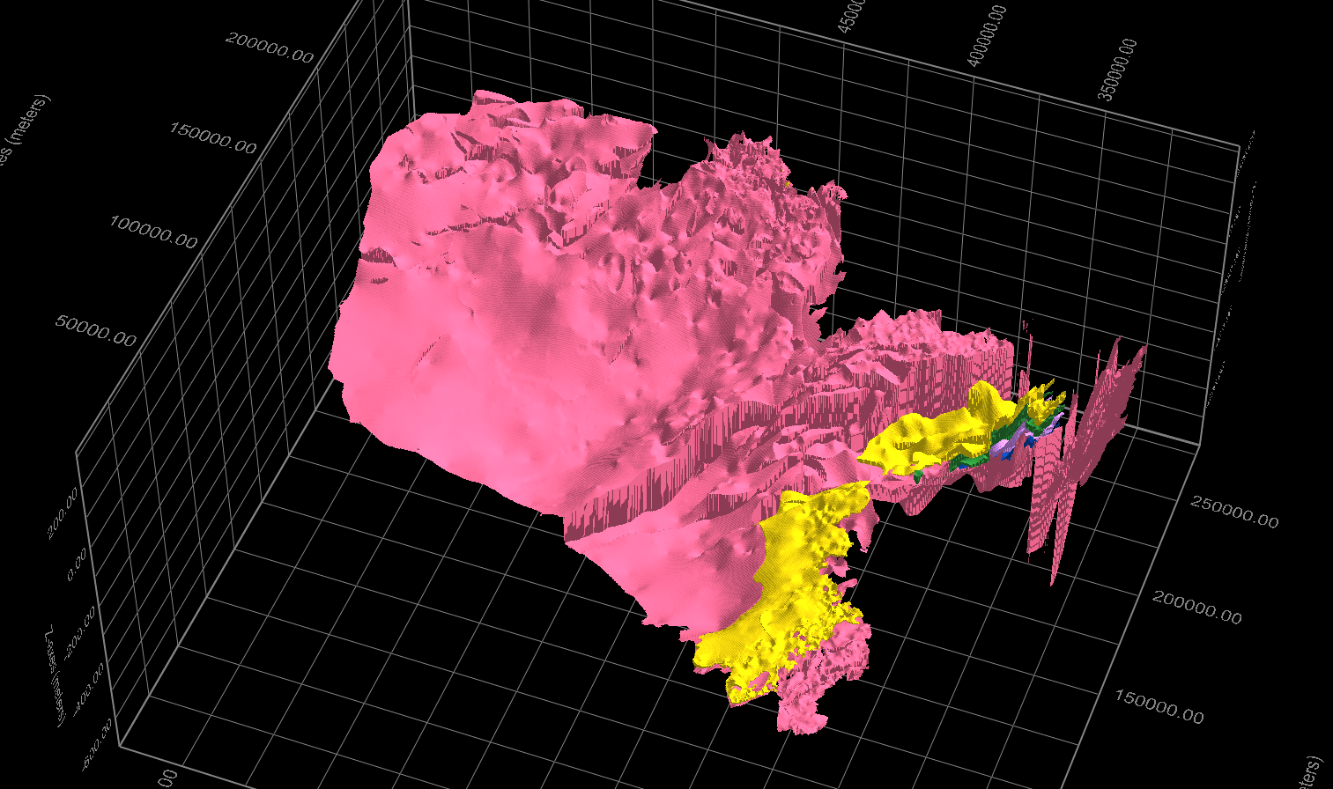
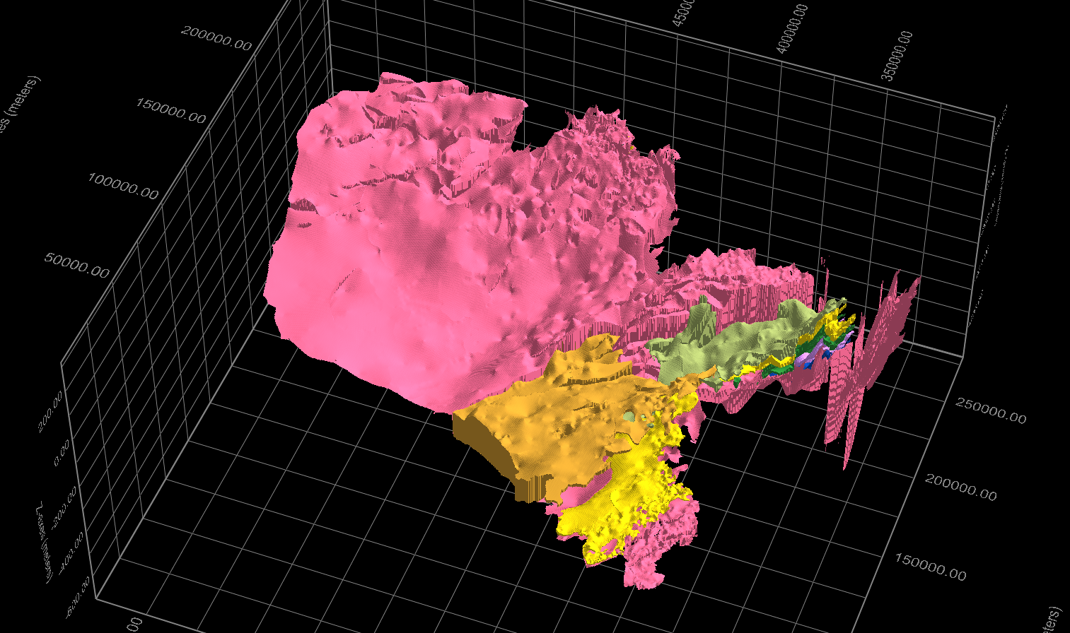
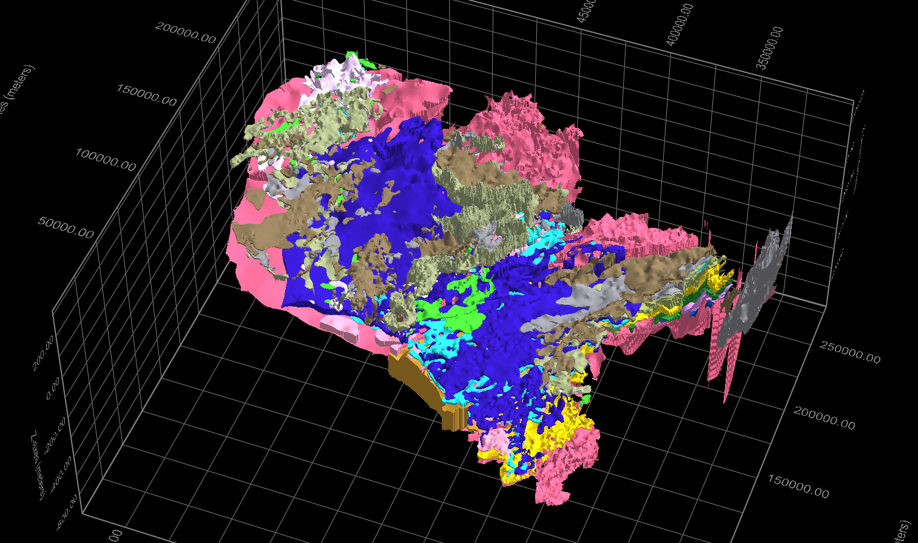
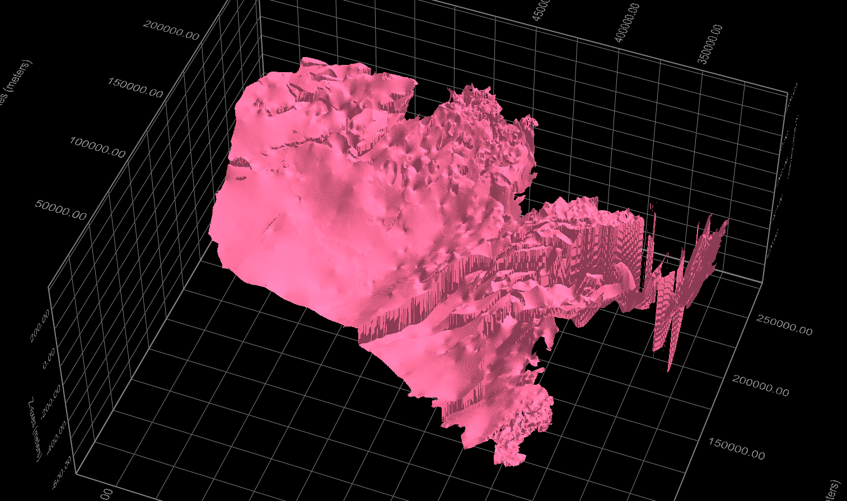
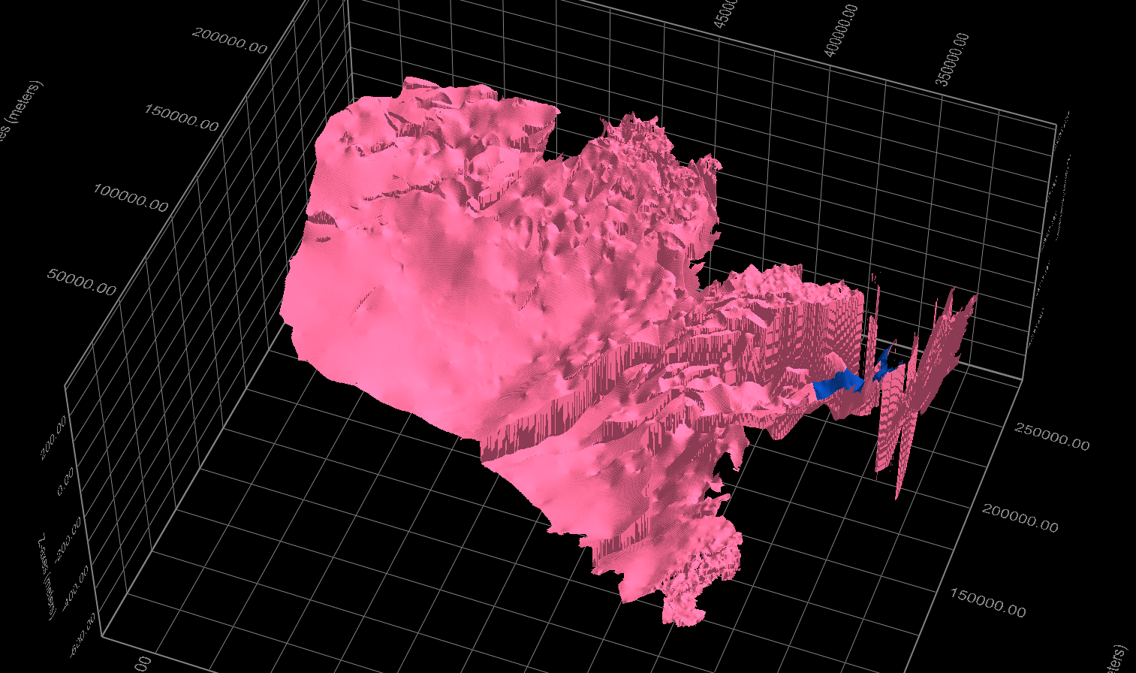
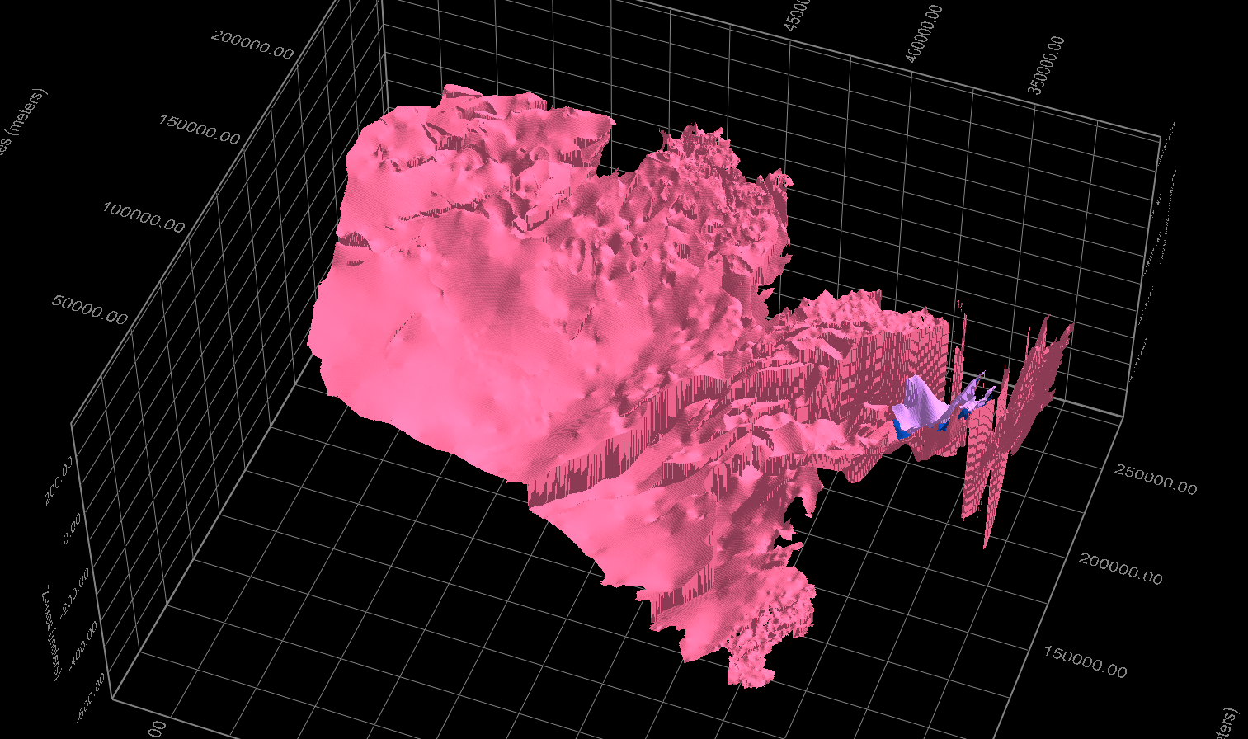
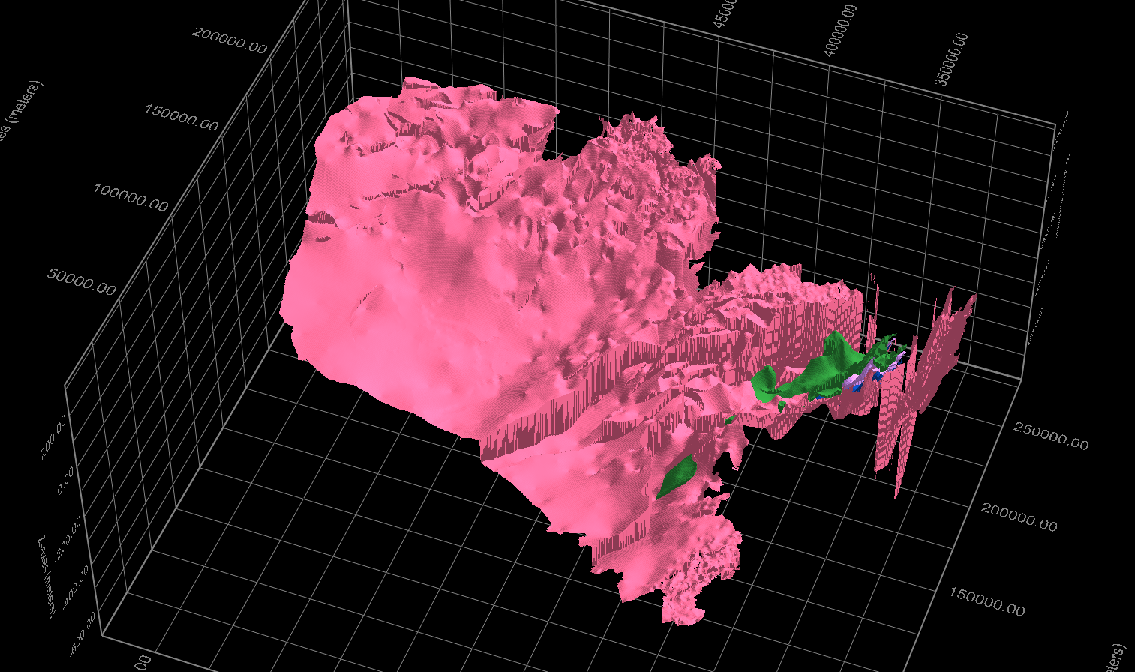
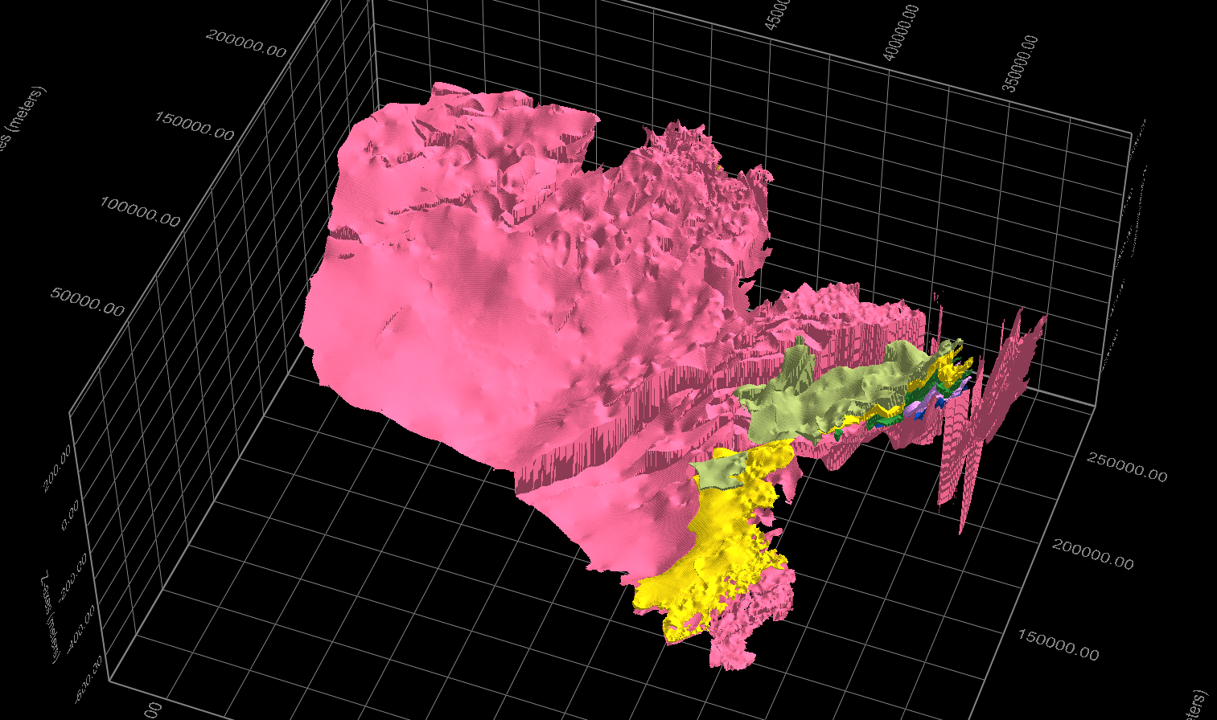
Geohydrological database REGIS (Geological Survey of the Netherlands: TNO)
Borehole information processed in Regiona Geological Information System

Slide 12
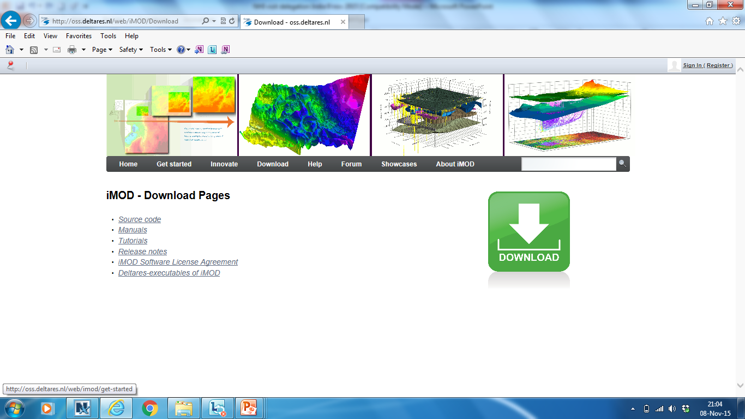
iMOD: special MODFLOW version + interface (open source, free executables)
groundwater modeling of extremely large model areas
high resolution, high performance
using binary files for faster handling of input/output (IDF, direct access)
up- and down-scaling techniques (flexibility resolution, extent)
fast 1-D, 2-D and 3-D visualization techniques

Slide 13
Modelcomponent -2 MetaSWAP (unsaturated zone)
Advanced, detailed processes in soil are needed, for example:
accurate approach of recharging ground water
input for effect module agriculture / nature
Input for processes water quality
Meta model of SWAP (Wageningen UR)
Richards’ equation simplified in 2 ‘normal’ differential equations (waterbalance + continuity of pressure heads)
Better handling (large scale) data
Reduction calculation time
Interface : crop – land surface – groundwater table
modelled as a continuum in addition to MODFLOW:
vegetation
surface
rootzone
Subsoil
groundwater table MODFLOW

Slide 14
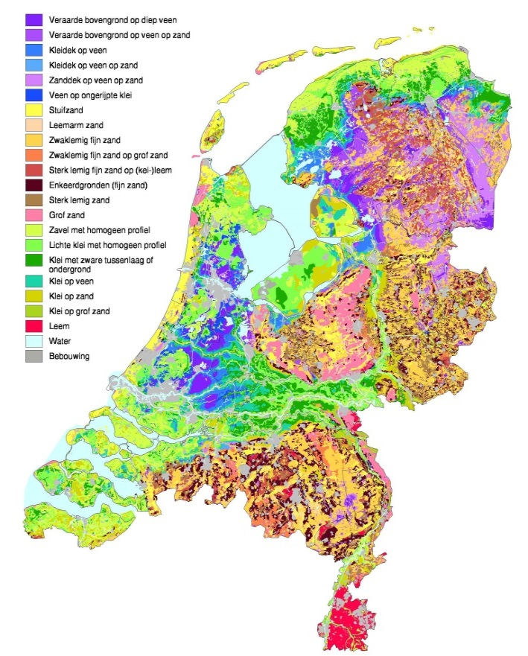
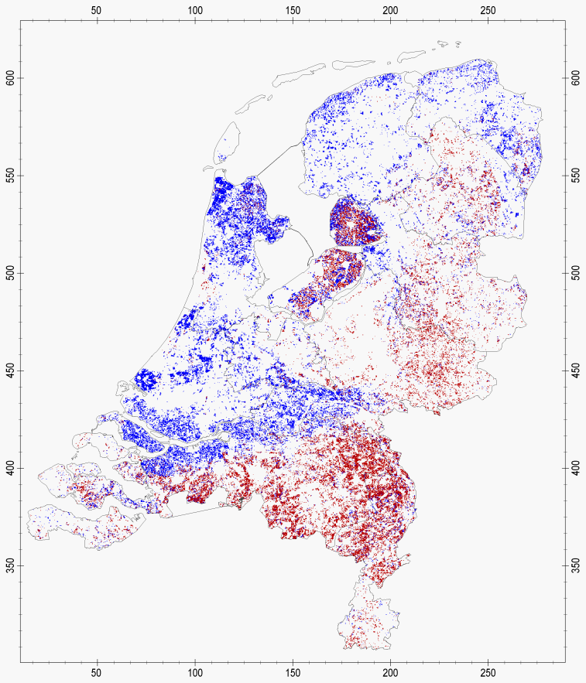
Input MetaSWAP: different databases, examples:
Soil physical data
Land use characteristics
Irrigation locations
data of different authorities
combined with research results
combined with rules of thumb

Slide 15
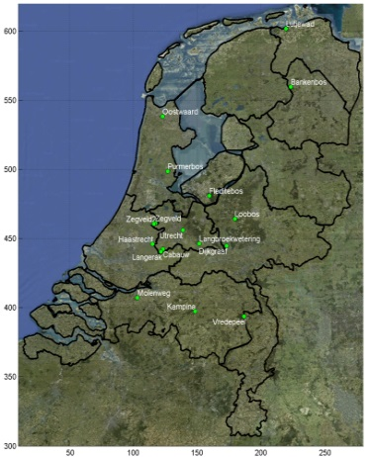
Output NHI a.o. calculated evapotranspiration compared to satellite data to improve model
NHI April – June 2006
(before adjustments)
Satellite data ETLook
(Terra + Aqua satellite)
Measurements
(Eddy-correlation)

Slide 16
3. surface water approaches by waterbalances in models for subcatchments + main surface waters
Irrigation demand
Water Distribution Network
(water supply)
MetaSWAP
drainage
infiltration
8500 subcatchments
MODFLOW
252 larger catchments
waterlevels
Within catchments (water demand)
simulation of level control, flushing, withdrawals
datasets used of a.o. regional water boards
management strategies water allocaton

Slide 17
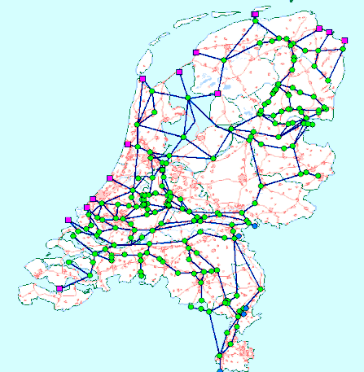
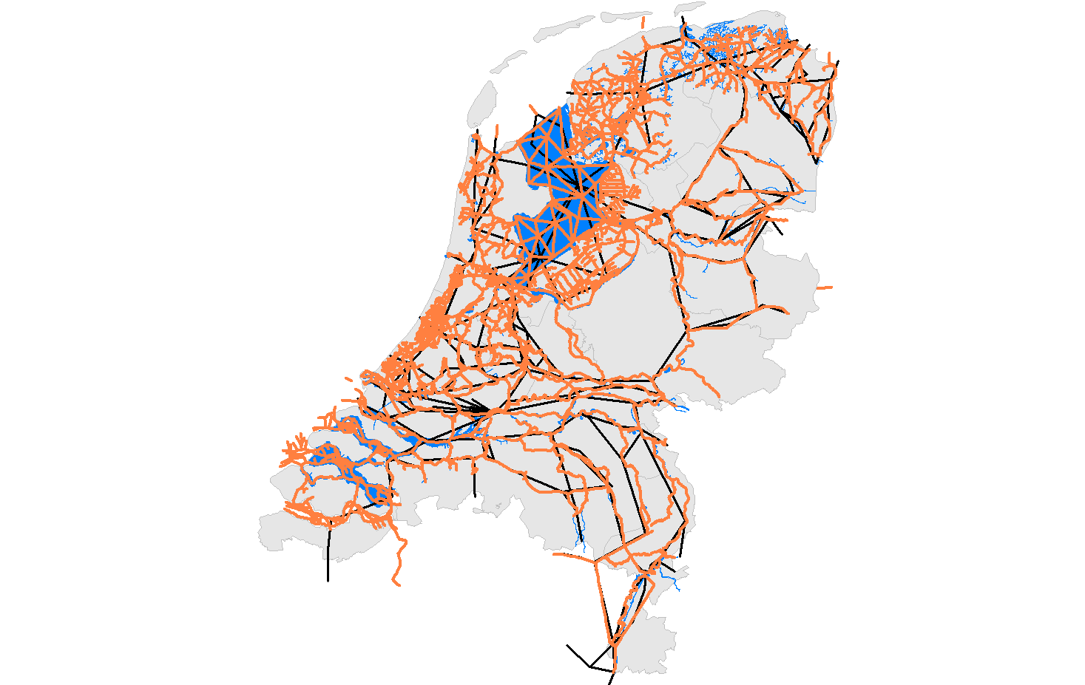
Example of combining regional + national data for Deltaprogramme: National Sobek Model
adjusted water balance model (black)
and generated hydraulic model (red)
Original water balance model

Slide 18
Overview NHI: coupling groundwater- surface water
Hydraulic model
MetaSWAP
Distribution
model
sprinkling
demand / allocation
Mozart
head,
recharge, storage
water demand / allocation
MODFLOW
drainageflux
waterlevel
Notes:
MODFLOW <-> metaSWAP: ONLINE phreatic groundwaterlevel <-> recharge
MODFLOW <-> MOZART: ONLINE drainage fluxes <-> water level
metaSWAP <-> MOZART: ONLINE sprinkling demand <-> sprinkling allocation
MOZART <–> DM: ONLINE water demand <-> water allocation
MODFLOW <-> DM: OFFLINE coupling drainage fluxes <-> water levels

Slide 19
NHI after 10 years: indispensible instrument for NL
National Policy analysis (e.g. Deltaprogramme)
Stimulus for discussions within Dutch hydrological community
Free data, software, knowledge (helpdesk) for all water parties NL (www.nhi.nu)

Slide 20
How was it done ?
Process organization
Desired functionalities
Programme
Team
Strategy
Team
Implementation programme
Guiding committees
Implementation
Team

Slide 21
So the first years were about
Demand driven development
Joining data and merging databases
Joining financial resources
4) Generating one high quality set of connected models
5) Many users/owners - one consistent system
Then based on that one system various developments were built:

Slide 22
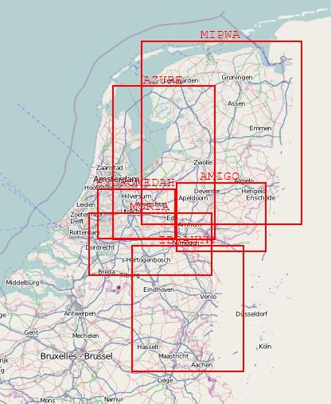
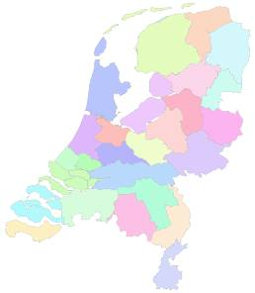
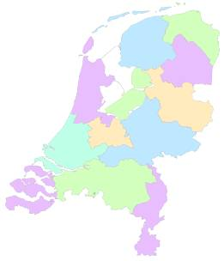
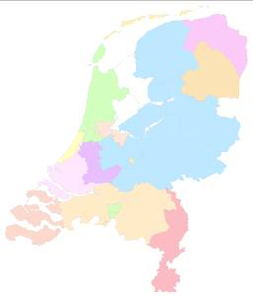
Development-1: toolbox NHI, present:
1 national + several regional models
Waterboards
Provinces
Drinking Water Companies

Slide 23
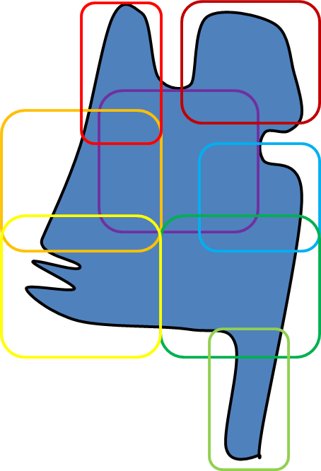
NHI as a toolbox (2015-2018) : data + software for automatically generating models on desired scale
Regional model application (fit for purpose)
Tools (iMOD and others)
preprocessing,,
coupling
scaling
optimization
version management
National model application (fit for purpose)
Sourcecodes
MODFLOW, SEAWAT,
MetaSWAP, SWAP, etc.
SOBEK, RTC, etc
Shared model data
Soil
Subsurface
Surface Water
.
Public data, other data
Soil
Subsurface
Surface Water
open data / source
flexible (fit for purpose)
reproducible
conistency regional - national
Notes:
Uitgangspunten
Instrument voor NL → regionale en landelijke model(toepassing)en verbinden
Samenwerken tbv verschillende toepassingen → fexibele koppelingen en generieke inzetbaarheid van modelcodes en tools
Samenwerken tbv delen kennis op verschillende schalen → gedeelde data (‘missende’ data en schematiseringen) verzamelen/genereren en delen
Efficiënter → opbouw via modules/componenten tbv hergebruik; als het al bestaat niet zelf ontwikkelen
Samen ontwikkelen → open source en voor alle financiers vrij inzetbaar
Ambitie samebrengen (inter)nationale ontwikkelingen → kennisinstituten ontwikkelen, beheren en onderhouden
Gezamenlijk ontwikkelen → samenwerken gebruikers/financiers en ontwikkelaars

Slide 24
Development-2: Real time drought modelling
forecast water supply, groundwater, moisture etc.
river discharges
Rhine, Meuse
meteo
07 November 2016

Slide 25
Thank you for your attention!
The technology is here,
The knowledge is here,
The data can be here
Where there’s a WILL, there’s a WAY

